Slide 1
Castor Oil
Industrial Crops and Products
Abhinav Mishra
8th Semester
Abhinav Mishra
131503
8th Semester

Slide 2
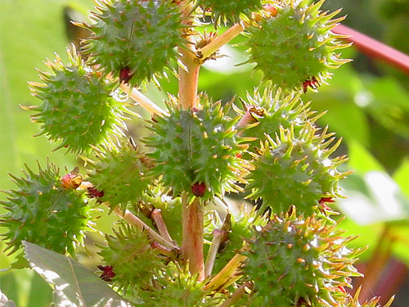
Castor Oil Plant Ricinus communis

Slide 3
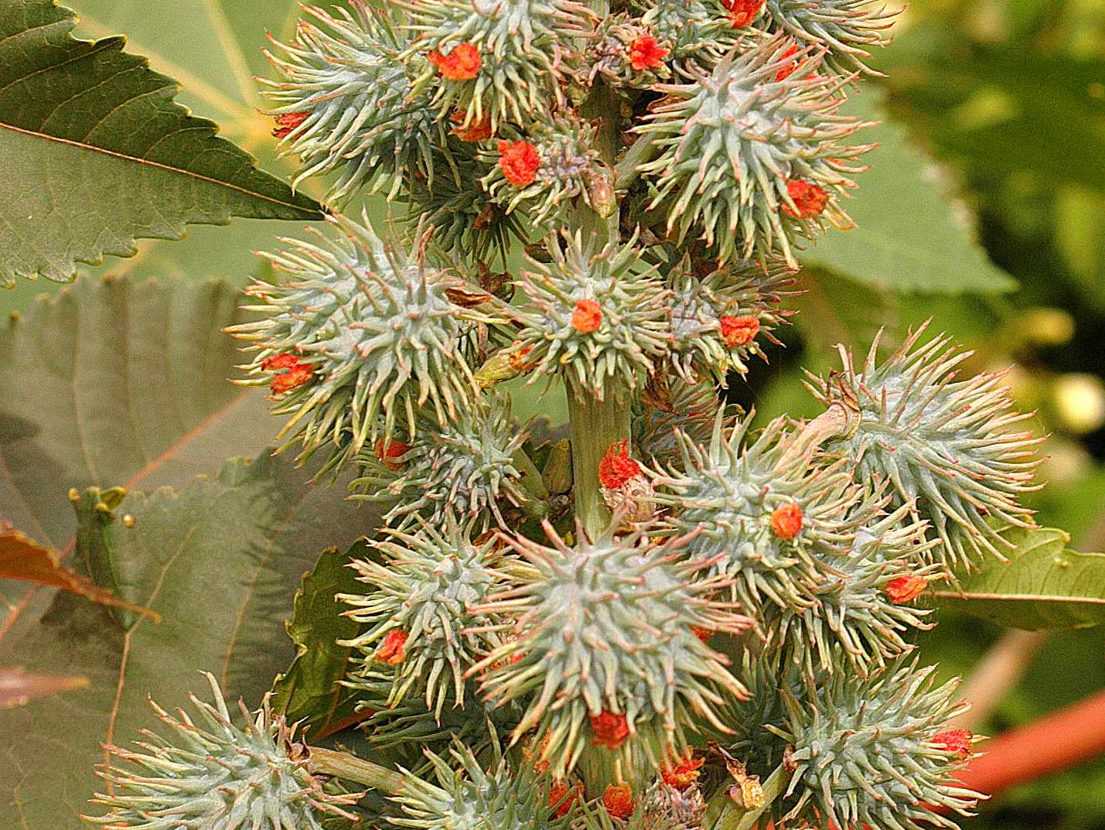
Post-bloom, with developing seed capsules

Slide 4
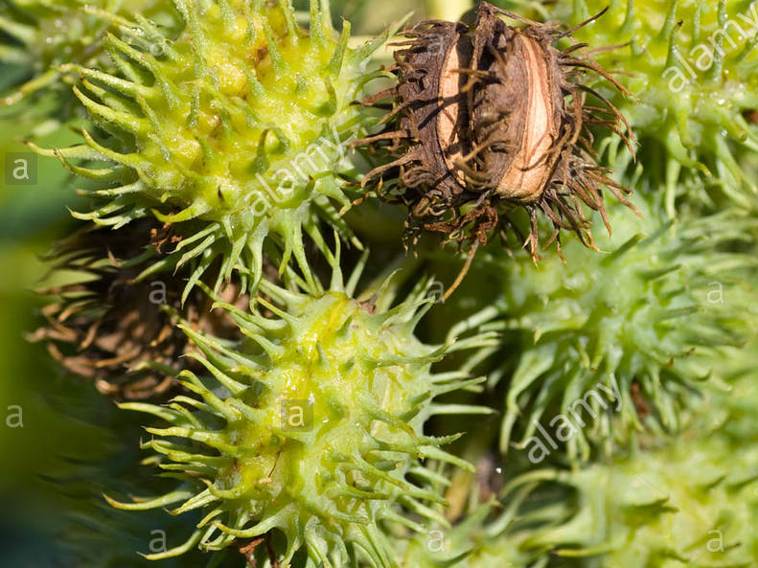
The green capsule dries up.

Slide 5
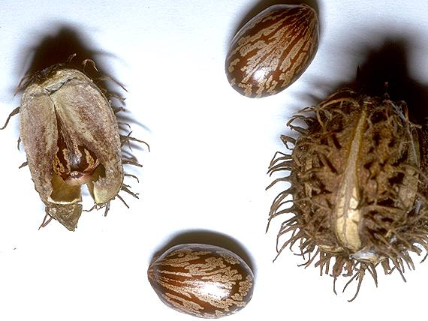
Capsule splits into three sections, forcibly ejecting seeds

Slide 6
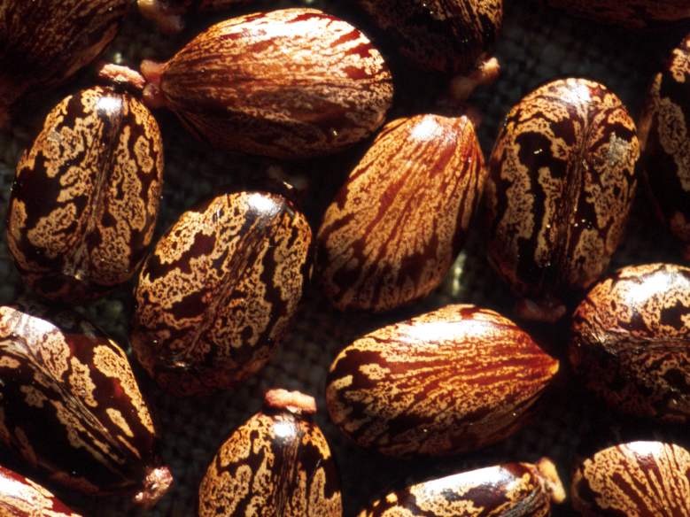
Seeds

Slide 7
Introduction
Castor oil is derived from the bean of the castor plant, Ricinus communis, belonging to the family Euphorbiaceae.
The seeds of the castor plant are produced in racemes, or clusters of capsules.
The capsules each contain three seeds protected by a hull that is removed prior to processing.
The seeds are mottled to varying extents, most often with shades of dark brown overlaying shades of light brown. Seeds of commercial varieties range from 250 to 1800/kg.

Slide 8
Properties
Castor oil is also known as ricinus oil, oil of Palma Christi, tangantangan oil, and neoloid. Typical of vegetable oils and most fats, castor oil is a triglyceride of various fatty acid.
Its uniqueness stems from the very high (87–90wt%) content of Ricinoleic acid, C₁₈H₃₄O₃.

Slide 9
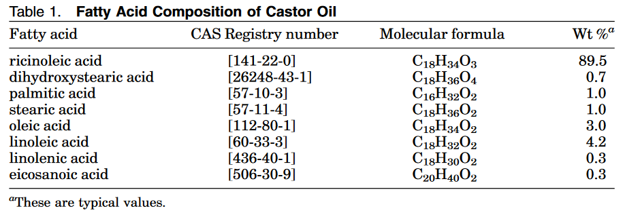

Slide 10
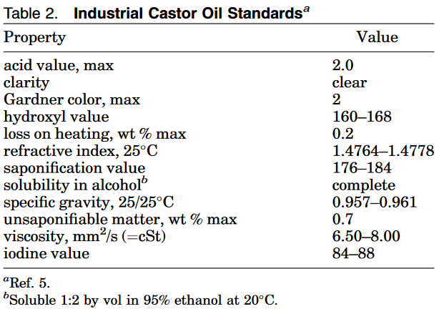

Slide 11
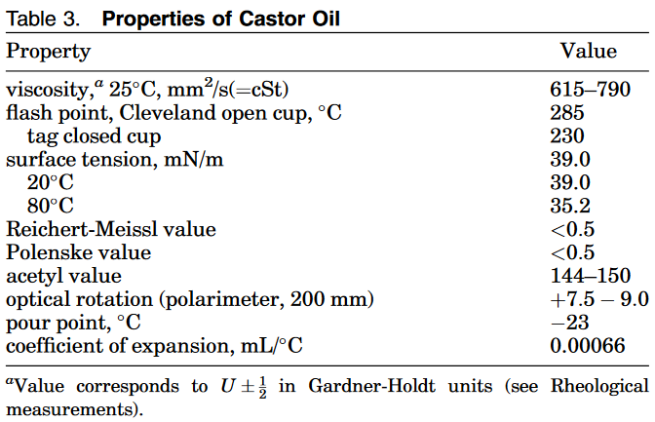

Slide 12
Commercial Processes
1. Preheating the seed in stack cookers prior to crushing in a hydraulic press or a continuous mechanical screw-type press commonly known as an expeller.
2. The press cake discharged from this mechanical processing contains 10–20wt % oil and is then processed in solvent extraction units to recover the residual oil.

Slide 13
A light colored, high quality medicinal type oil is recovered.
Castor oil recovered from hydraulic or continuous mechanical screw presses requires reﬁning to remove toxic proteins, gums, and foreign matter while improving the color and reducing the free fatty acid content.

Slide 14
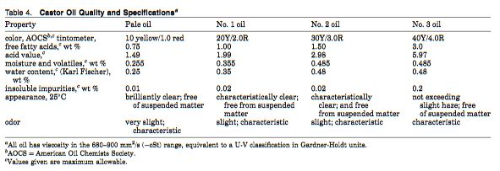

Slide 15
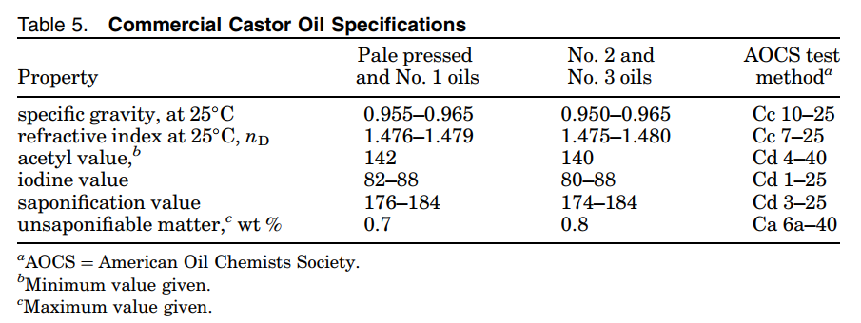

Slide 16
Oil Recovery
According to the specifications of ICOAI
1
Degumming
Oil/dissolved/dispersed proteinaceous materials are treated with 3–5 wt % water at a temperature of 70–80 C and passed through a decanter-type centrifuge to separate the gums from solation
2
Removal of free fatty acids
Use of caustic soda solutions to neutralize the excess free fatty acids
3
Deodorization
Volatile components present are removed by nitrogen or steam stripping operations carried out at 160C under less than 1.5 kPa (11 mm Hg) pressure.

Slide 17
Economic Aspects
India is the largest producer of castor seeds in the world. China and Brazil follow.
Historically India, Brazil, and China have been the key producing countries meeting global requirements.
India production ranges between 250,000-350,000 t/year.

Slide 18
Health and Safety Factors
The toxicological properties of this castor oil have not been fully investigated :
Castor oil may cause eye and skin irritation and irritation of the digestive tract.
Castor oil is not listed as a carcinogen by ACGIH, IARC, NTP or Ca Prop 65
During ﬁre, irritating and highly toxic gases may be generated by thermal decomposition or combustion.
Runoff from ﬁre control or dilution may cause pollution.
Use water spray, dry chemical, carbon dioxide, or chemical foam to extinguish ﬁre.
Store in a tightly closed container.
Store in a cool, dry well-ventilated area away from incompatible substances

Slide 19
Uses
Castor oil is unique among all fatty oils. It is the only renewable vegetable oil resource having a hydroxyl group structure.
Many years ago, castor oil was primarily used for medicinal purposes and as a general industrial lubricant.
Later derivatives of castor oil were produced and the many more uses were found for the oil. Castor oil and its derivatives are important commodities to the chemical industry.

Slide 20
Polyamides (Nylon – 11) [Air brakes/Powder Metal Coatings]
VESTAMID Terra DS and HS - both polymers derived from castor oil
Urethanes Foams (Thermal insulations and structural support)
Coatings (High abrasion resistance on steel plates and ﬂexibility on aluminum plates and PVC cloth)
Lubricants (Non - volatile, high temperature lubricants for jet engines)
Castrol B353 is a blended SAE 40 formulation employing castor oil - avoids combustion chamber deposits and sludge build-up
Textiles
Enhance fiber finish, Uniform Shade Levels
Notes:
VESTAMID Terra DS ( PA 1010) is a product from a leading chemical industry named EVONIK (German)
High mechanical strength
Good UV and chemical resistance
Low water absorption
High translucency

Slide 21
Cosmetics
Basic lipstick contains 20–44wt % castor oil, which also acts as an ideal dispersant for pigments [nonirritating and noncomedogenic]
Haircare [Foam enhancement and conditioning]
Antiperspirant sticks
Surfactants and Detergents
PEG-40 castor oil , a surfactant that has co-solvent properties and is utilized as a fragrance solubilizer
Pearlescence in Shampoos
Sulfated castor oil is also used in dishwashing compounds as a hand softener
Biofuels
Evogene Ltd announced that biosynthetic parafﬁn kerosene (bio jet fuel) produced from the company’s castor varieties meets key international standards for alternative fuels (in collaboration with NASA and U.S. Air Force). ASTMD7566 is written for Fischer Tropsch process fuel

Slide 22
References
Naughton, F. C. (1974). Production, chemistry, and commercial applications of various chemicals from castor oil. Journal of the American Oil Chemists Society, 51(3), 65-71. doi:10.1007/bf00000015
Naughton, F. C. (2011). Castor Oil Kirk-Othmer Encyclopedia of Chemical Technology: John Wiley & Sons, Inc., 1-20. doi:10.1002/0471238961.0301192014012107.a01.pub2

Slide 23
Thank you !

